Slide 1

Exploration and Planning on Bridge Building Presentation
Jenab Vohra
Nihal Gupta
Shobana Amirthalingam
Amrit Siew

Slide 2
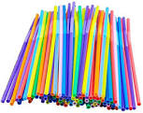

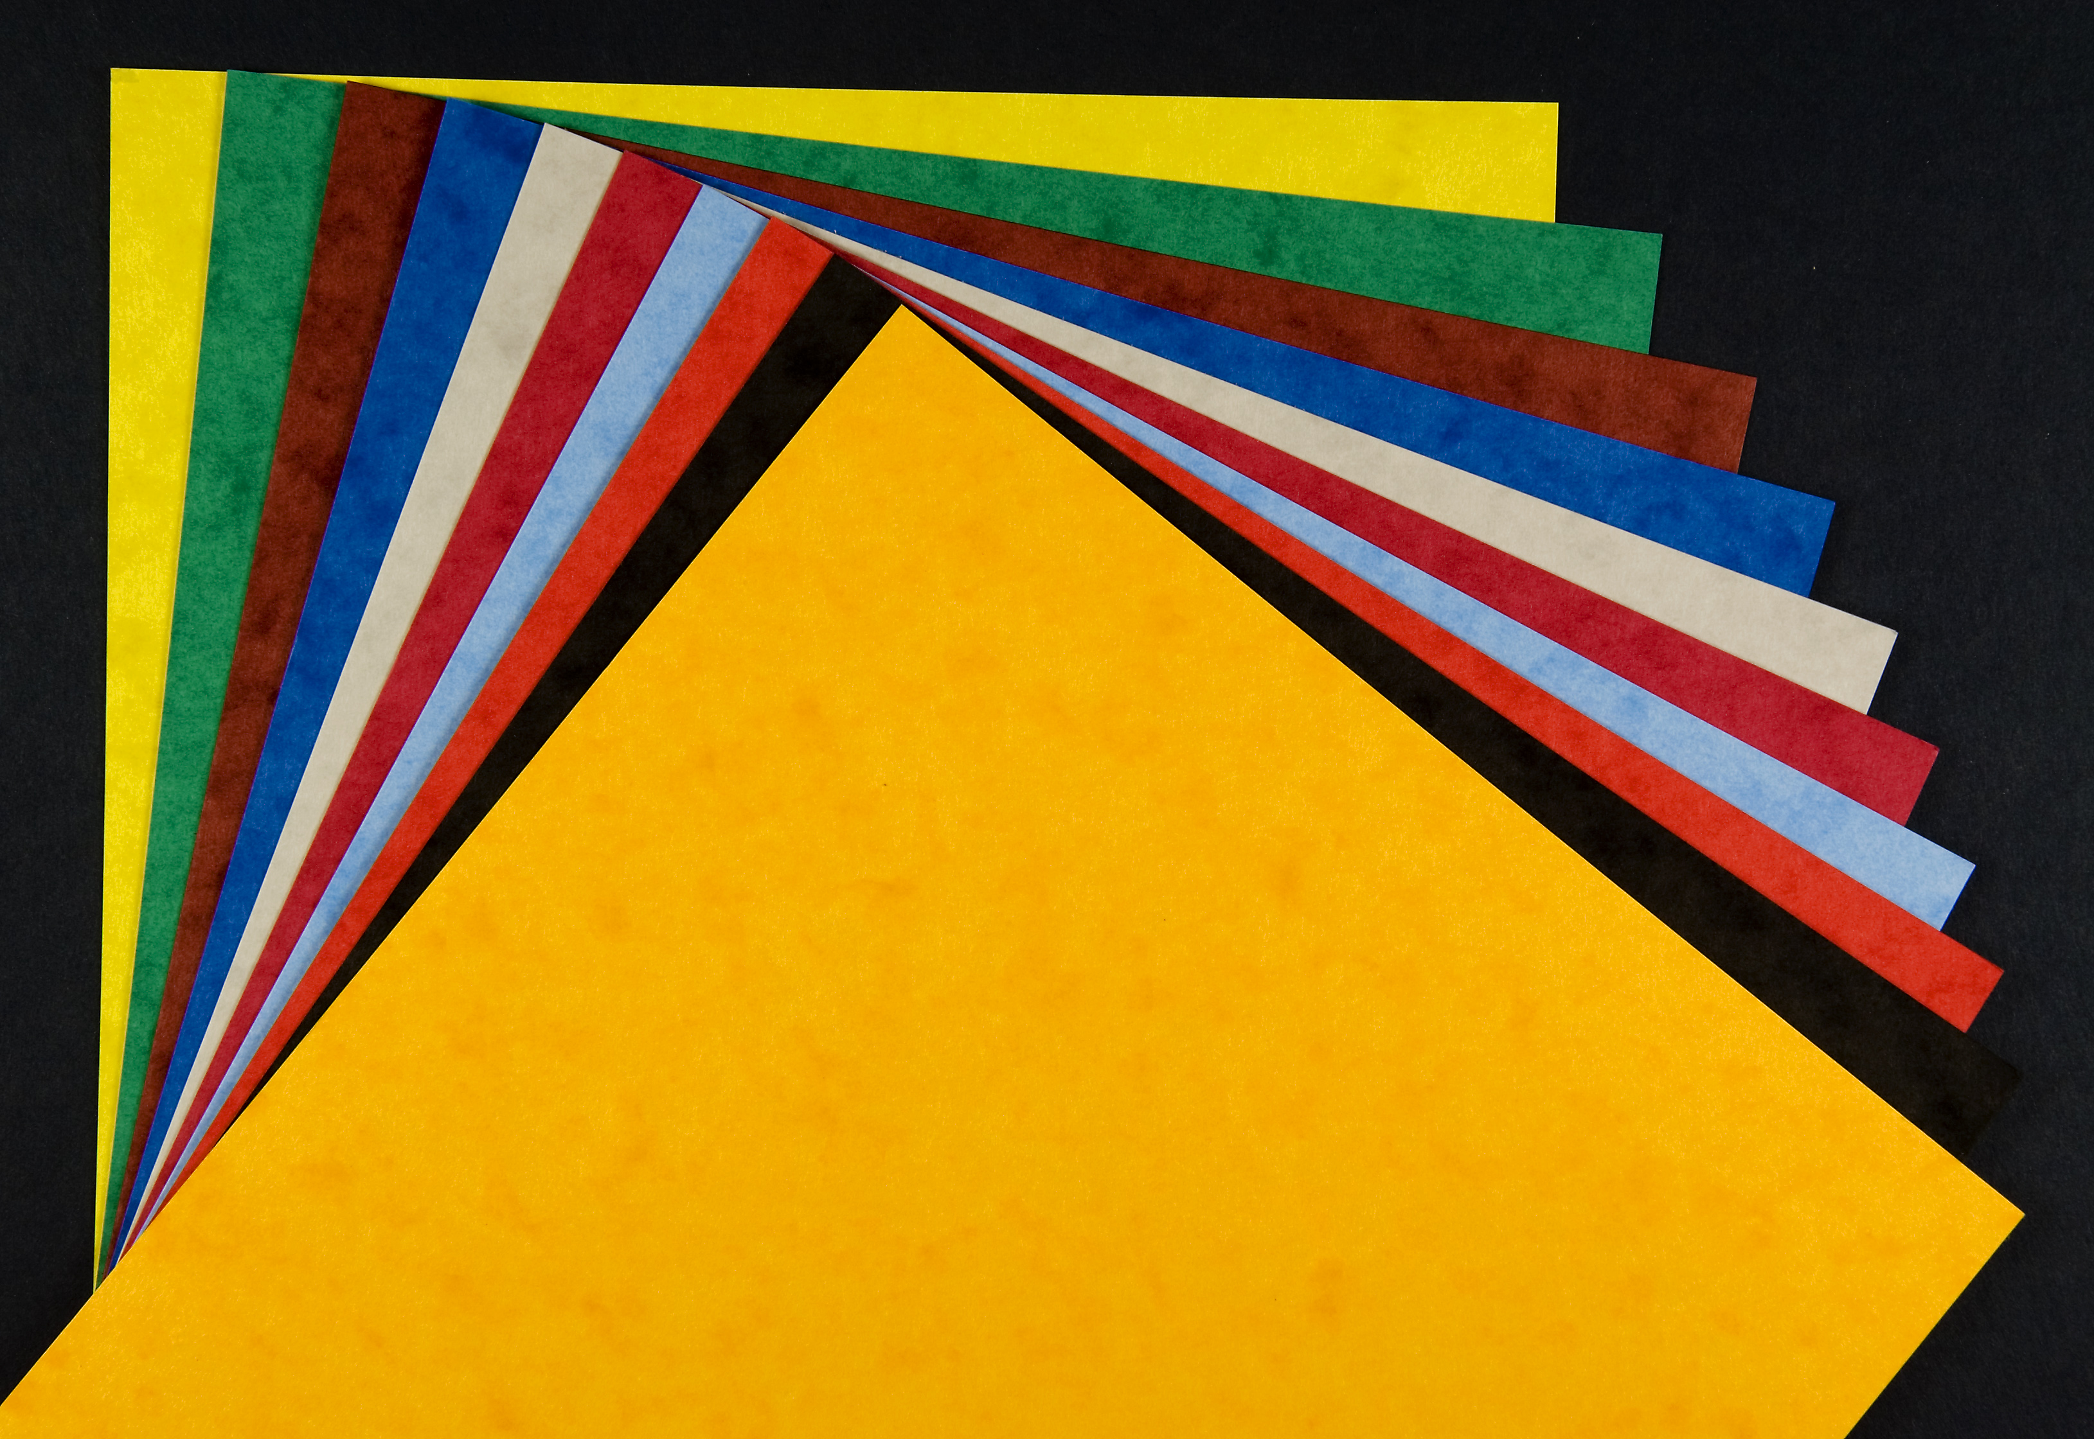
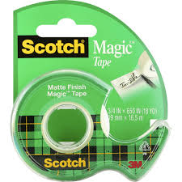
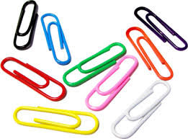
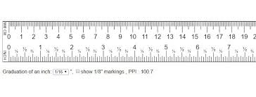
Materials
Straws
Paper
Scissors
Rulers
Paper Clips
Scotch Tape
Notes:
For this bridge building exercise, the objective is to build a functional bridge out of:
Straws
Paper
Paperclips and
Scotch tape
The second requirement is the bridge’s ability to withstand the weight of the Rubin textbook. For this presentation,
Jenab will present the Planning phase – What are the major features and the timeline
Shobana will present the Timeline – working with Jenab’s numbers, the chart projects the ideal completion rate of the features
Nihal covers the Project Cost – based on the hours of work, rate of pay and materials required
I, Amrit, will discuss what the design of the bridge will look like

Slide 3
Planning
The bridge with the main components as straws and paper will be divided in following major tasks with the estimation of the time each needs to complete and allocating the T-shirt sizes as the priority check.
Main Features | Estimated | T-Shirt Sizes
Set the pillars | 80 | XL
Build the bridge | 160 | XL
Make safety railings | 20 | M
Create Ramps | 80 | M
Make Bridge Signage | 10 | S
Make the Road Lines | 10 | XS
Make the Roadway | 10 | XS
Assemble | 30 | L
Note: Quality check is taken on each and every task to make sure everything is good
Notes:
The last time the bridge was made with Legos. This gave us knowledge and experience of how bridge building is done.
This time with new equipment straws and paper as the major components the bridge will be made as following :
The division is made of bridge into 8 major features with assigned T-shirt sizes and an estimated time to complete it.
The pillars will be made as strong as possible with the straws framing it and compressed paper.
The bridge will made up of layered straws and paperclips, tapped together and with the triangular reinforcement below to hold maximum weight of the Rubin text.
Safety railings will me made of straws
The ramps will be made out of paper, like the last bridge with straws reinforcing the frame.
The signage will be made accordingly with the size described and holding name for our team.
Making of road line , so that vehicles will stay in line.
Ensure the measurements with the length ,breadth & width and maintain quality check on every parts we make.
The focus will be more on the weight holding property of the bridge with the minimum applicable cost and using resources mentioned.
Assembling of the parts that are build in order to make the whole bridge stand.
Also the time allocation is total time of 4 people working on one task. We have divided in 400 minutes duration which is divided according to the tasks and its priorities.
Lastly I have assigned the T-shirt sizes to the tasks which makes more clear which tasks should be completed with more precautions.

Slide 4
Timeline
Notes:
The above Burndown chart depicts the estimated duration to complete the project based on total minutes.
The X-axis of the chart represents the total minutes required for completion of the bridge construction project.
Whereas, Y-axis represents the duration. i.e., number of sprints required for completion of the project.
After completing bridge construction with Lego, having that experience we have estimated the time required for construction of bridge with straws and papers.
As per our estimation we will finish 200 minutes of work in the first sprint, i.e. Sprint 1 – 5 days, 4 team members, 10 minutes each
And we will finish the remaining 200 minutes of work during our second sprint, i.e. Sprint 2 – 5 days, 4 team members, 10 minutes each
Thus, the burndown chart will help us to understand the overall overview of the project, making it easier while execution of the project.

Slide 5
Cost
Resource Name | Type | Rate/min | Sprints | Total mins | Total
Amrit | Worker | $2.00 | 2 | 100 | $200
Nihal | Worker | $2.00 | 2 | 100 | $200
Jenab | Worker | $2.00 | 2 | 100 | $200
Shobana | Worker | $2.00 | 2 | 100 | $200
Material | Type | Rate/piece | Quantity(No.) |  | Total
Straws | Material | $0.10 | 400 |  | $40
Paper | Material | $0.16 | 60 |  | $10
Scissor | Material | $8.00 | 2 |  | $16
Ruler | Material | $2.00 | 2 |  | $4
Paper Clips | Material | $0.02 | 100 |  | $2
Scotch tape | Material | $10.00 | 3 |  | $30
Miscellaneous | Other expense |  |  |  | $50
Totals |  |  |  |  | $952
Notes:
We are having a team of four workers for the construction of the bridge. Salary of each worker is 120/hr. As per our estimates, the bridge will be get completed within 2 sprints and each sprint of 5 days. The worker will be spending 10mins per day for construction.
Total salary of worker will be = Number of workers * Number of sprints * total time spent= 4*2*100= $800
We have decided to use Straws, paper, scissor, paper clips and scotch tape for construction of a bridge. We have added an extra quantity of material to our inventory for avoiding any materials shortages due to some wastages. If materials are unused, It will be returned to the supplier as per our agreement.
Miscellaneous expense of $50 included in the budget to cover extra expenses like travel cost of worker, loss due to injury of a worker or other unexpected cost.
Our total budget stands at $952

Slide 6
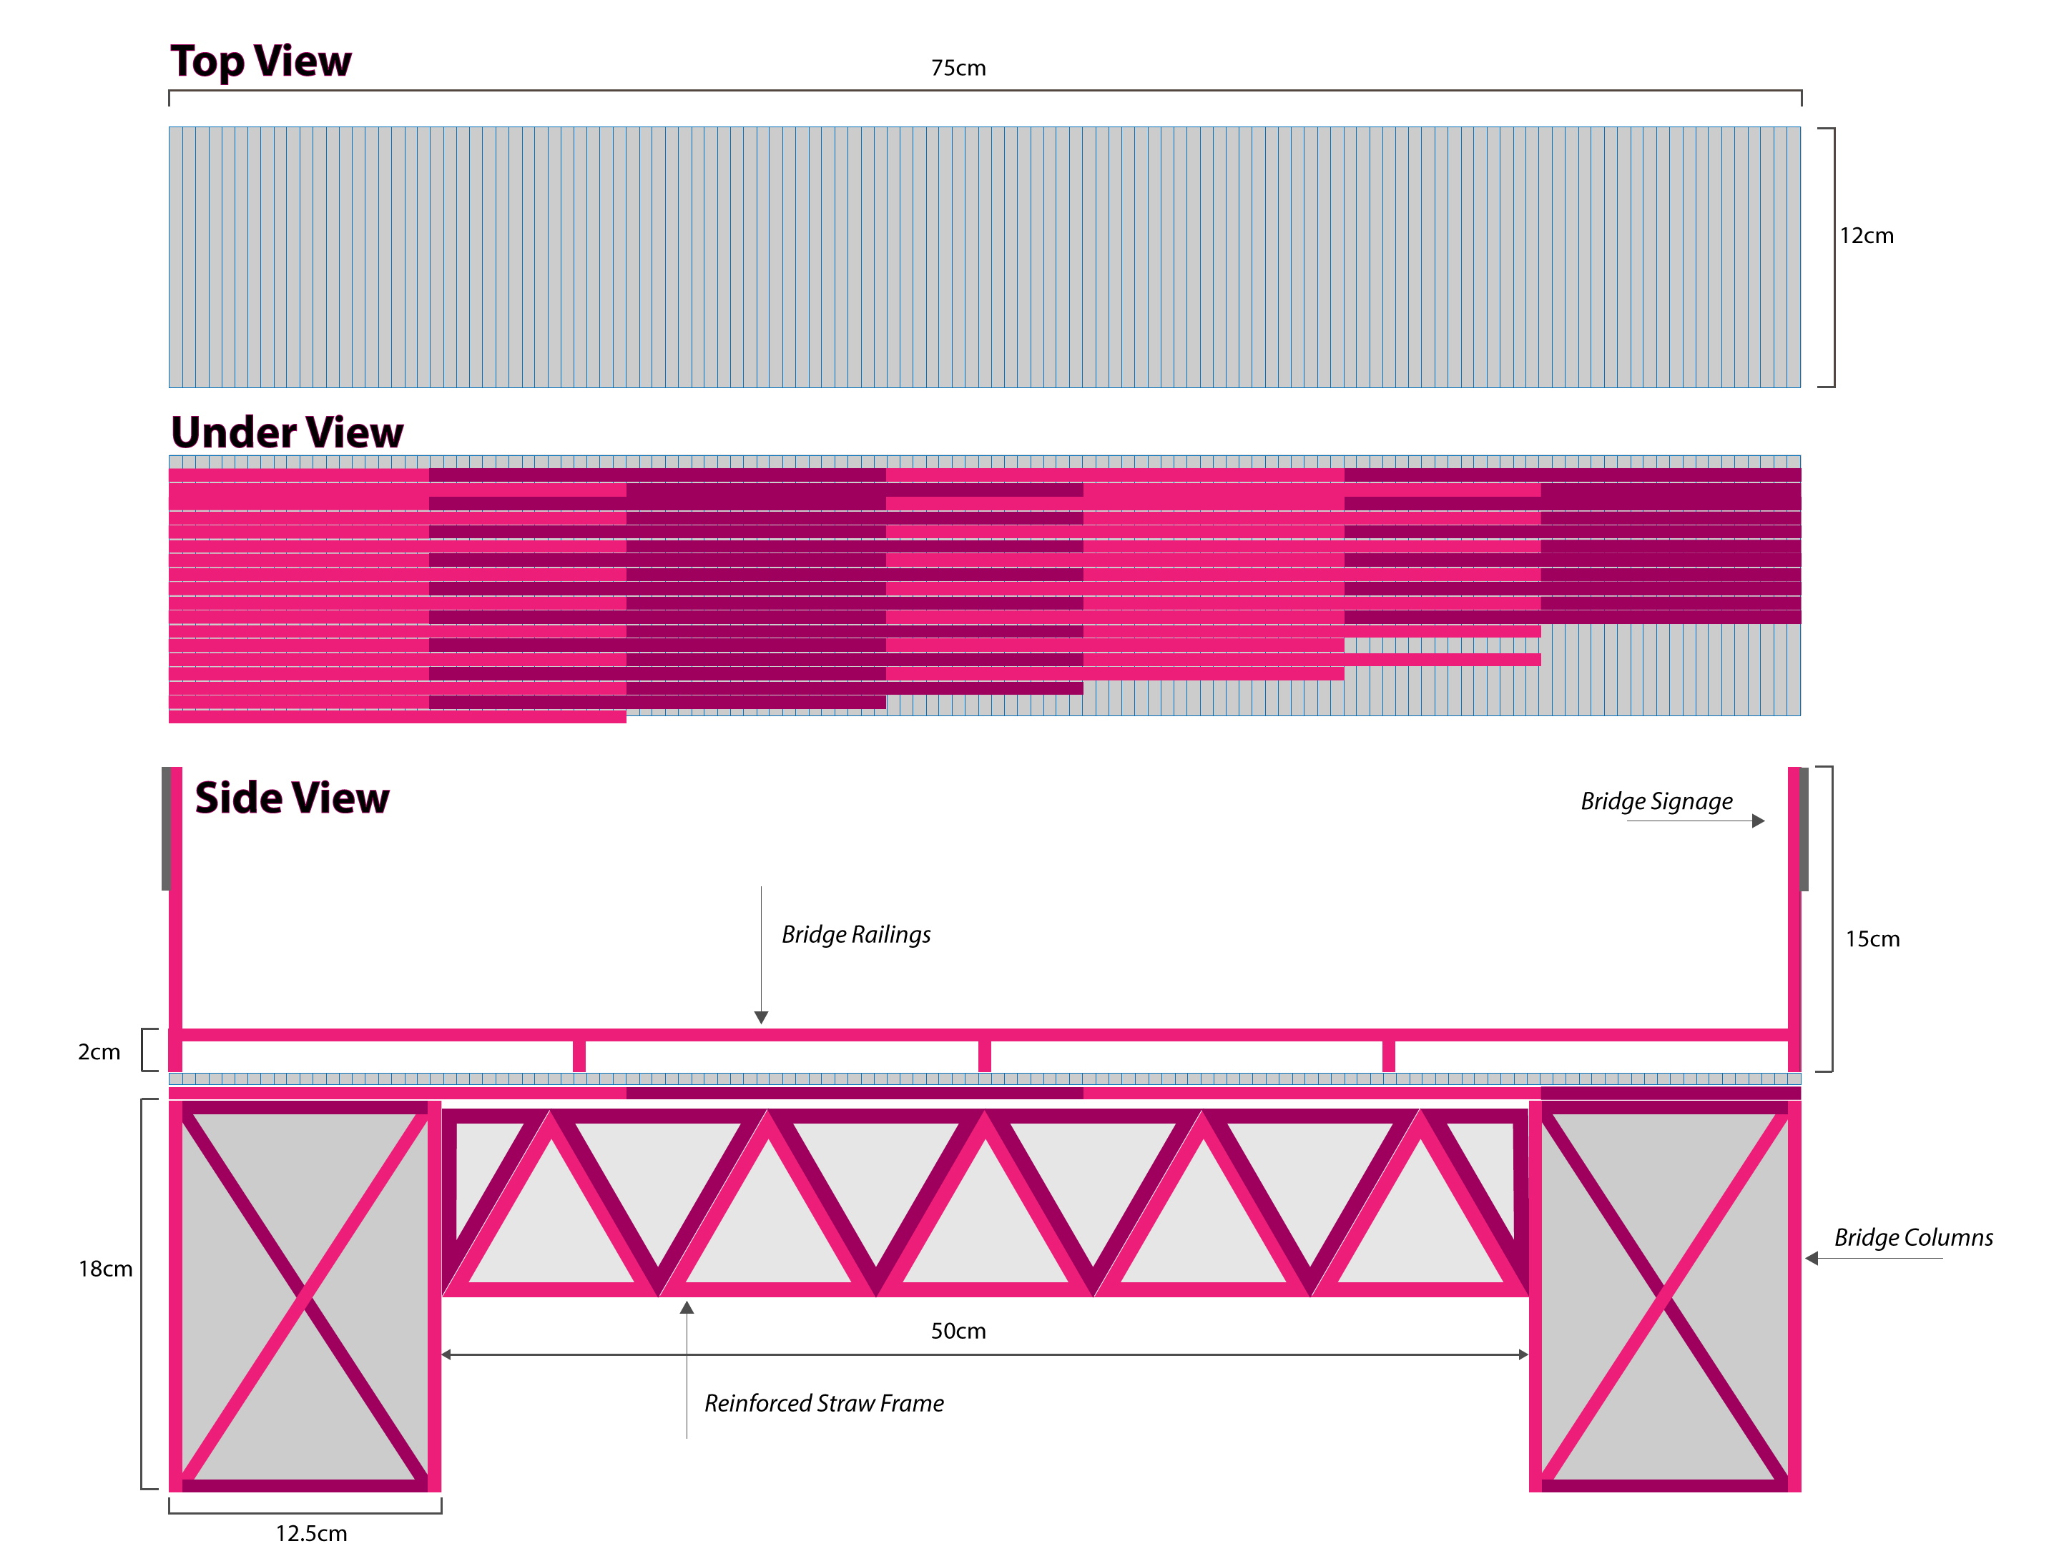
Design
Notes:
For the bridge design, the focus is on its structure.
Firstly, straws cut to 12cm will be laid out side by side to cover the length of the bridge
A second layer of straws will run in across the length of the bridge in an offset design
The straws will be taped together with a layer of paperclips for added reinforcement
For the columns, the straws will be used to create the frame and paper will be compacted and stuffed into the frames
Under the bridge, straws and paper will be turned into triangle grids and run across the width of the bride for further reinforcement
The ramps ( not captured in this above visualization), will be 19 cm high and 40 cm long, running along the ends of the bridge
2 cm high railings will run the length of the bridge with 15cm high signage at the entrance and exit
Finally, the length of the bridge will have a sheet of paper simulating the roadway, with a strip down the middle to separate the lanes.

Slide 7
THANK YOU
Notes:
This concludes our presentation, thank you for your time and if you have any questions, please let us know.

